Slide 1
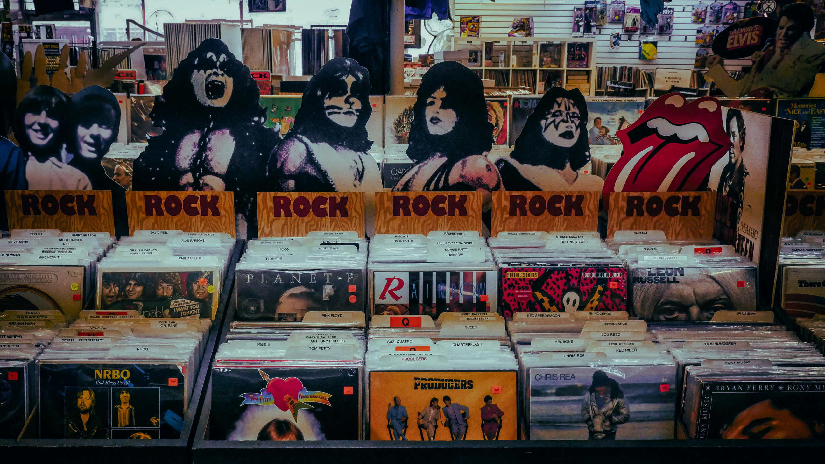
MUSIC STORE ANALYSIS
SQL PROJECT
- AKSHAY SHIRBHATE

Slide 2



PROJECT OBJECTIVE
1. ANALYZE SALES DATA TO REVEAL TRENDS AND PATTERNS IN THE MUSIC STORE'S REVENUE GENERATION.
2. IDENTIFY ACTIONABLE INSIGHTS FROM MUSIC SALES DATA TO INFORM STRATEGIC DECISIONS AND PROPEL BUSINESS ADVANCEMENT.
MUSIC STORE ANALYSIS

Slide 3
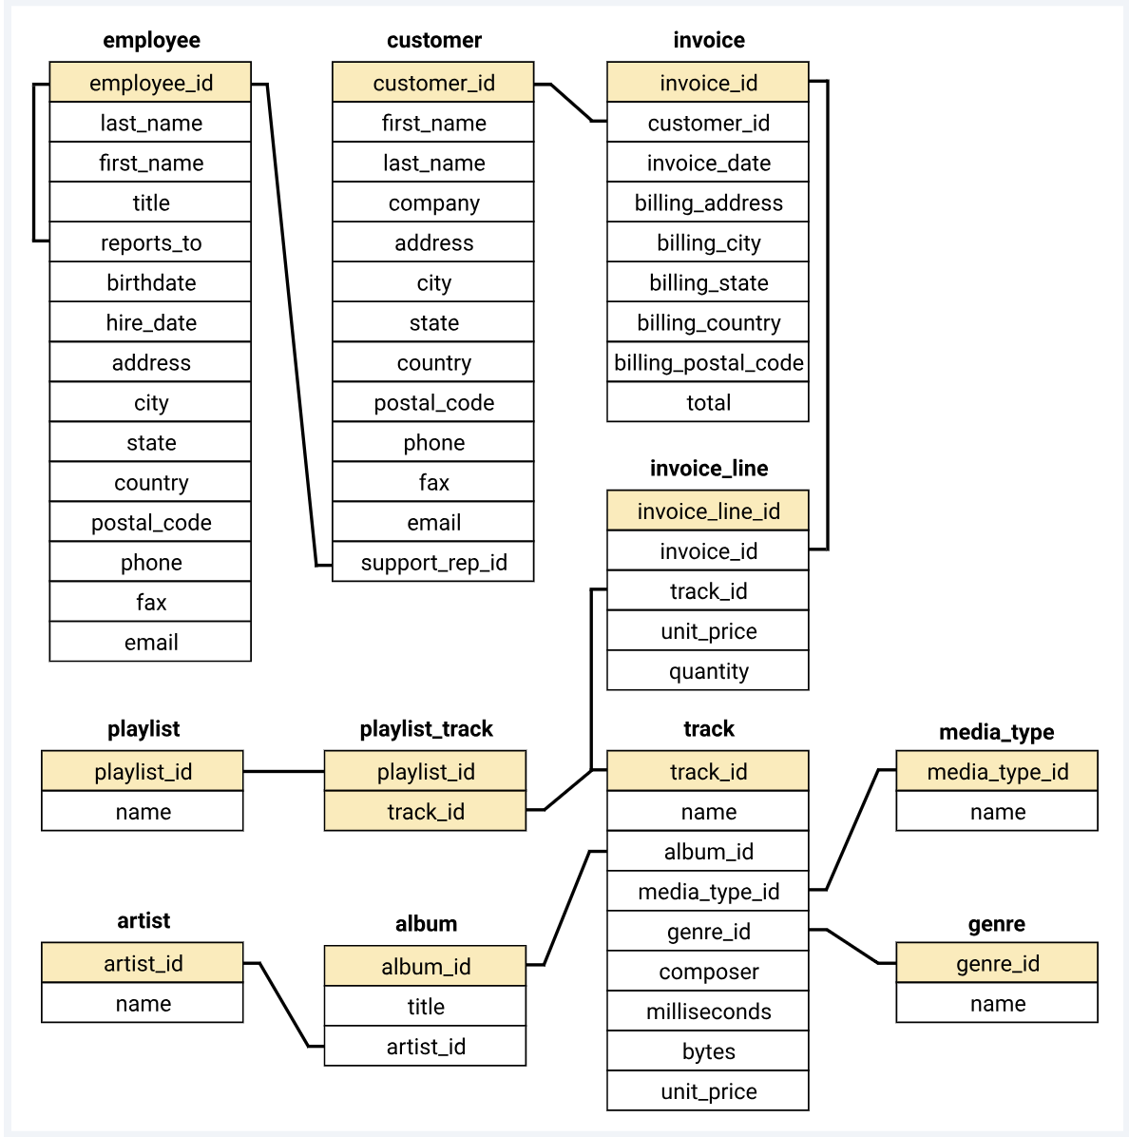

DATABASE SCHEMA

Slide 4



DIVISION OF QUESTIONS
EASY
MODERATE
ADVANCE
ORDER BY, LIMIT, COUNT,
GROUP BY, SUM, JOIN
JOIN,COUNT, AVG, GROUP BY, ORDER BY, LIMIT
CTE, RECURSIVE CTE, ROW_NUMBER, JOIN, GROUP BY, ORDER BY, SUM, LIMIT
MUSIC STORE ANALYSIS

Slide 5
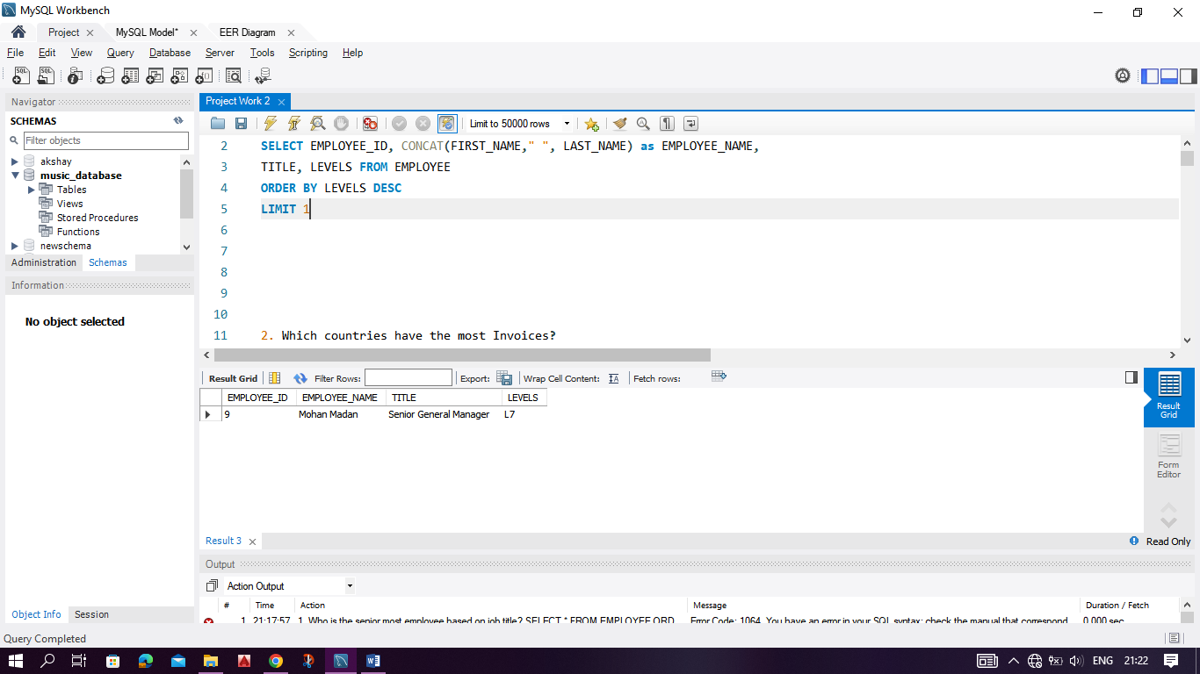
EASY
1. Who is the senior most employee based on job title?
OUTPUT
MUSIC STORE ANALYSIS

Slide 6
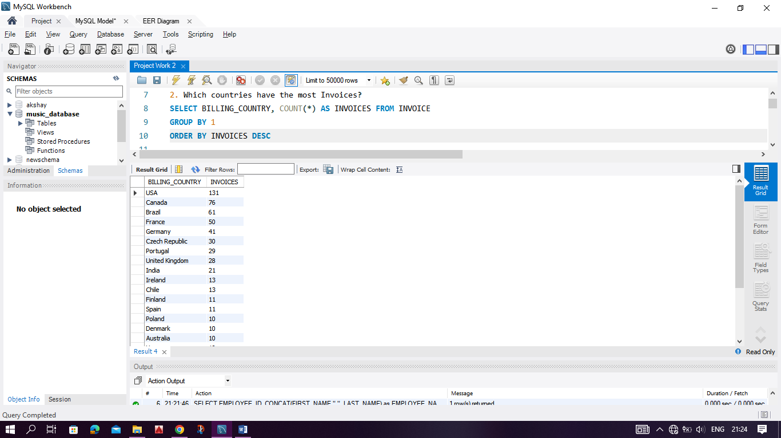
2. Which countries have the most Invoices?
OUTPUT
MUSIC STORE ANALYSIS

Slide 7
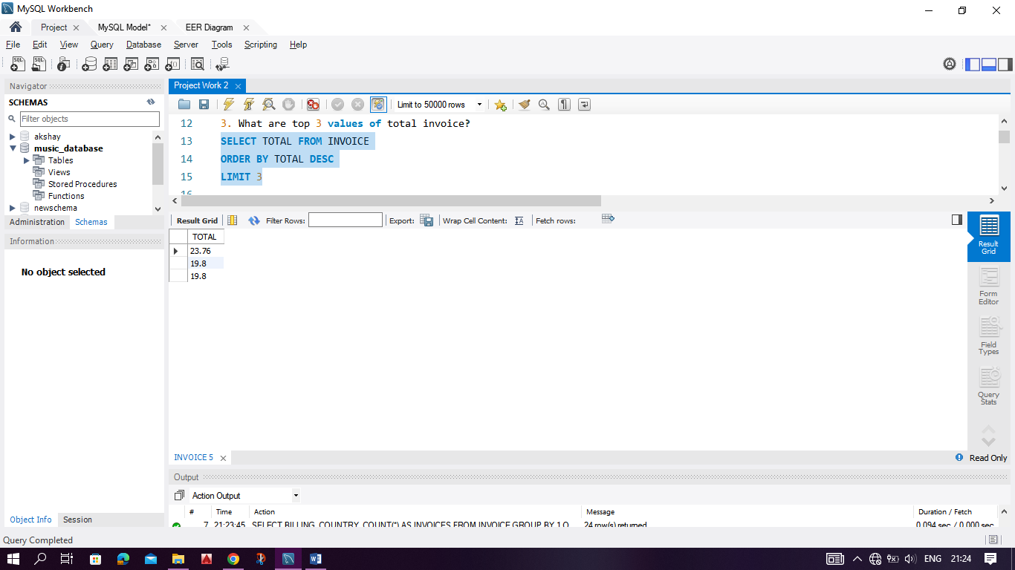
3. What are top 3 values of total invoice?
OUTPUT
MUSIC STORE ANALYSIS

Slide 8
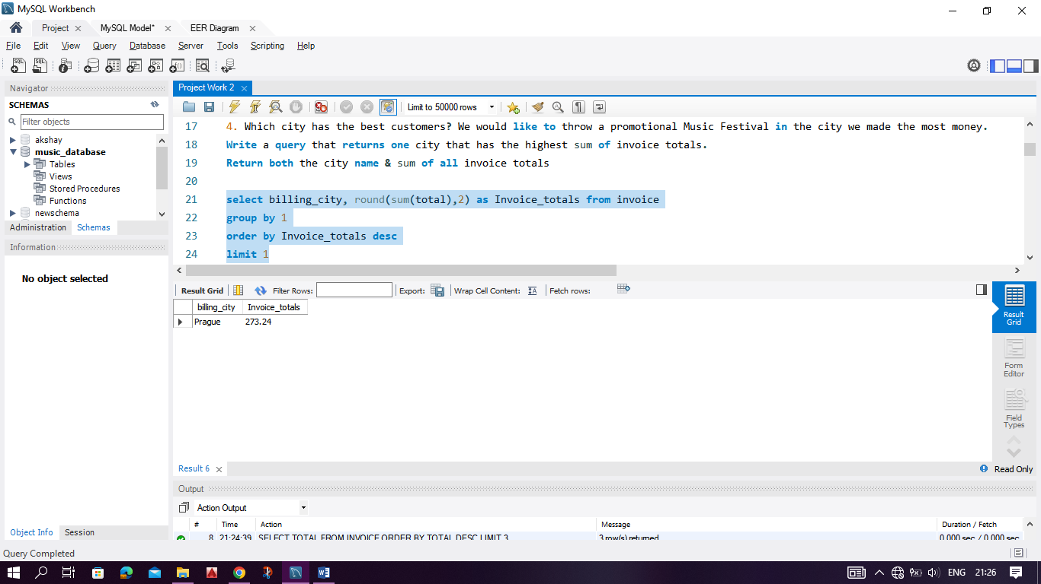
4. Which city has the best customers? Write a query that returns one city that has the highest sum of invoice totals. Return both the city name & sum of all invoice totals.
OUTPUT
MUSIC STORE ANALYSIS

Slide 9
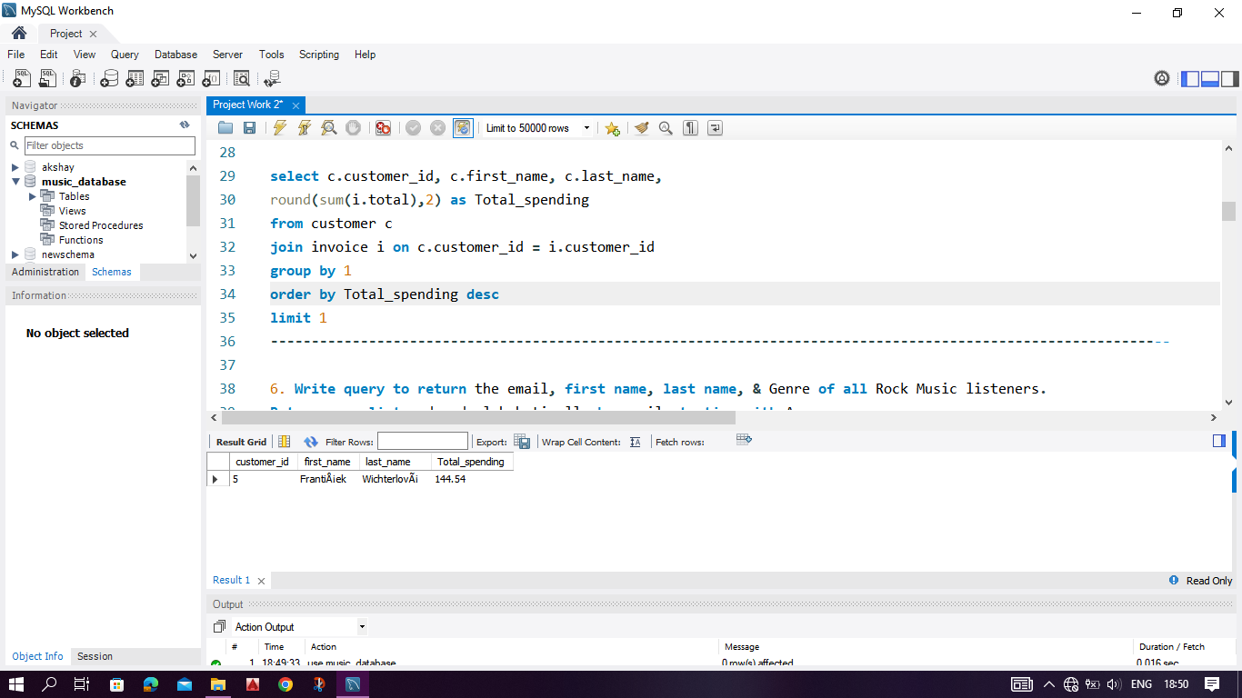
5. Who is the best customer? The customer who has spent the most money will be declared the best customer. Write a query that returns the person who has spent the most money.
OUTPUT
MUSIC STORE ANALYSIS

Slide 10
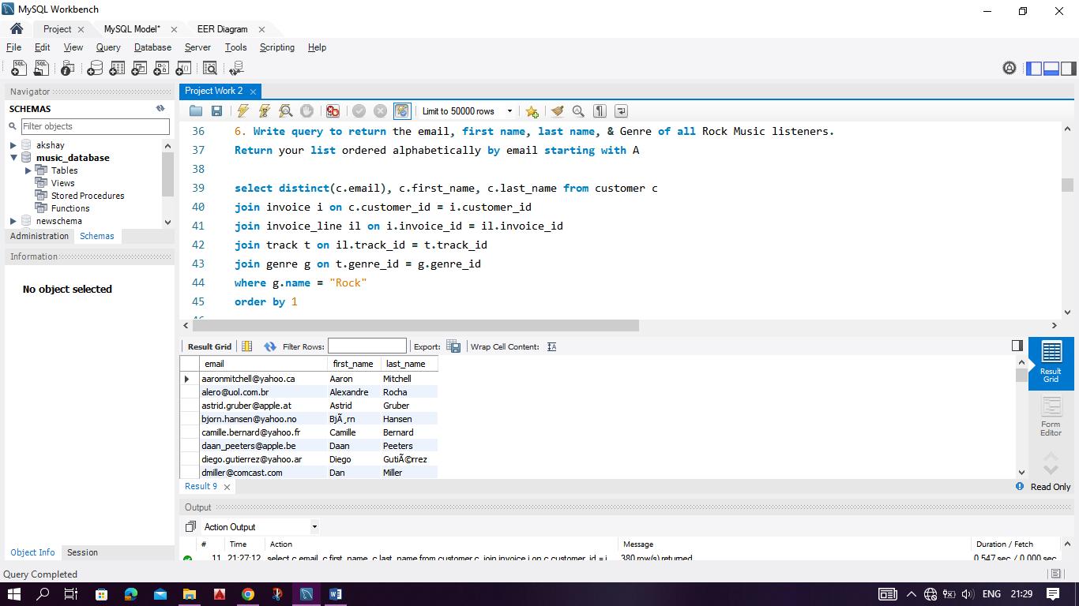
MODERATE
1. Write query to return the email, first name, last name, & Genre of all Rock Music listeners. Return your list ordered alphabetically by email starting with A.
OUTPUT
MUSIC STORE ANALYSIS

Slide 11
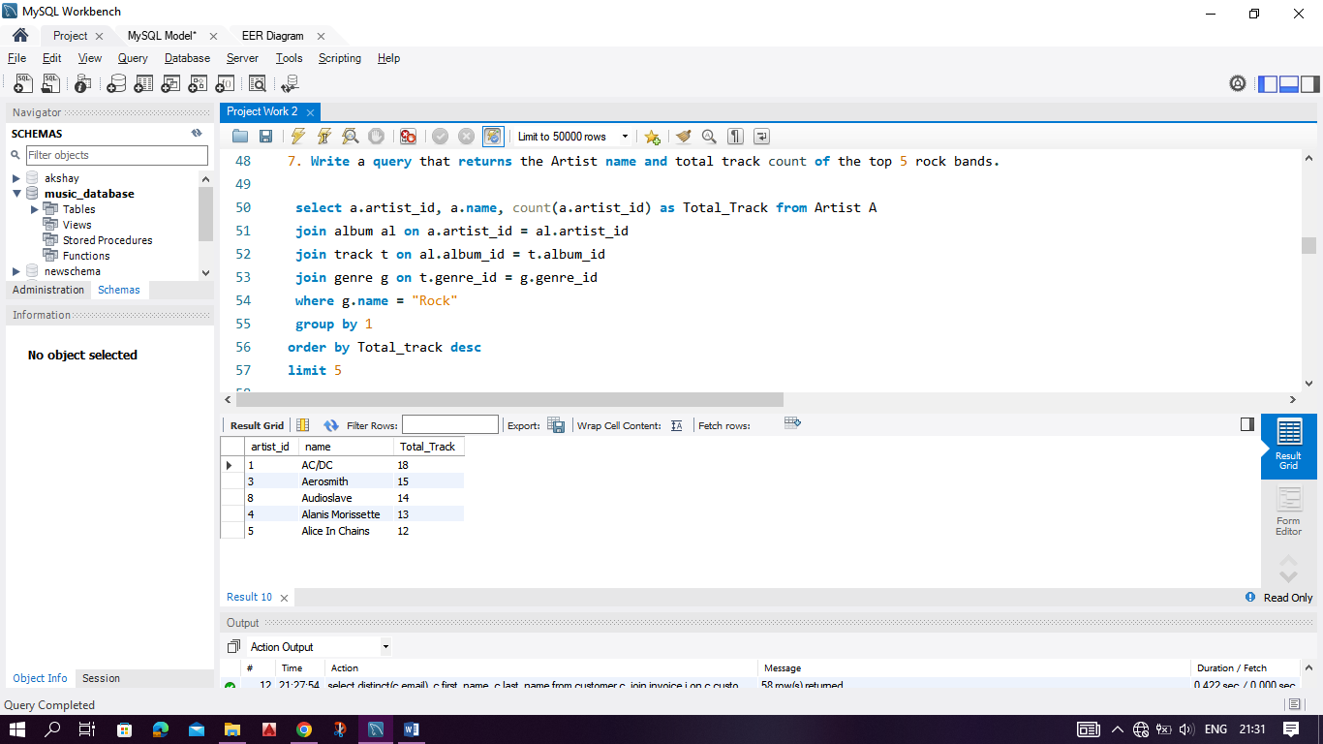
2. Let's invite the artists who have written the most rock music in our dataset.
Write a query that returns the Artist name and total track count of the top 10 rock bands.
OUTPUT
MUSIC STORE ANALYSIS

Slide 12
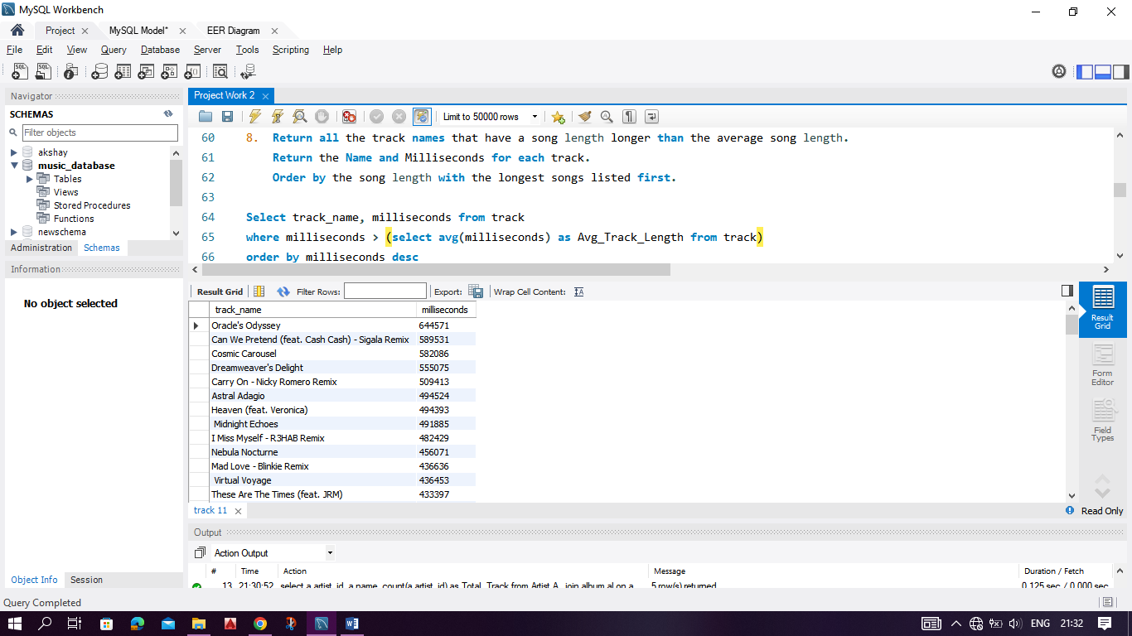
3. Return all the track names that have a song length longer than the average song length. Return the Name and Milliseconds for each track. Order by the song length with the longest songs listed first.
OUTPUT
MUSIC STORE ANALYSIS

Slide 13
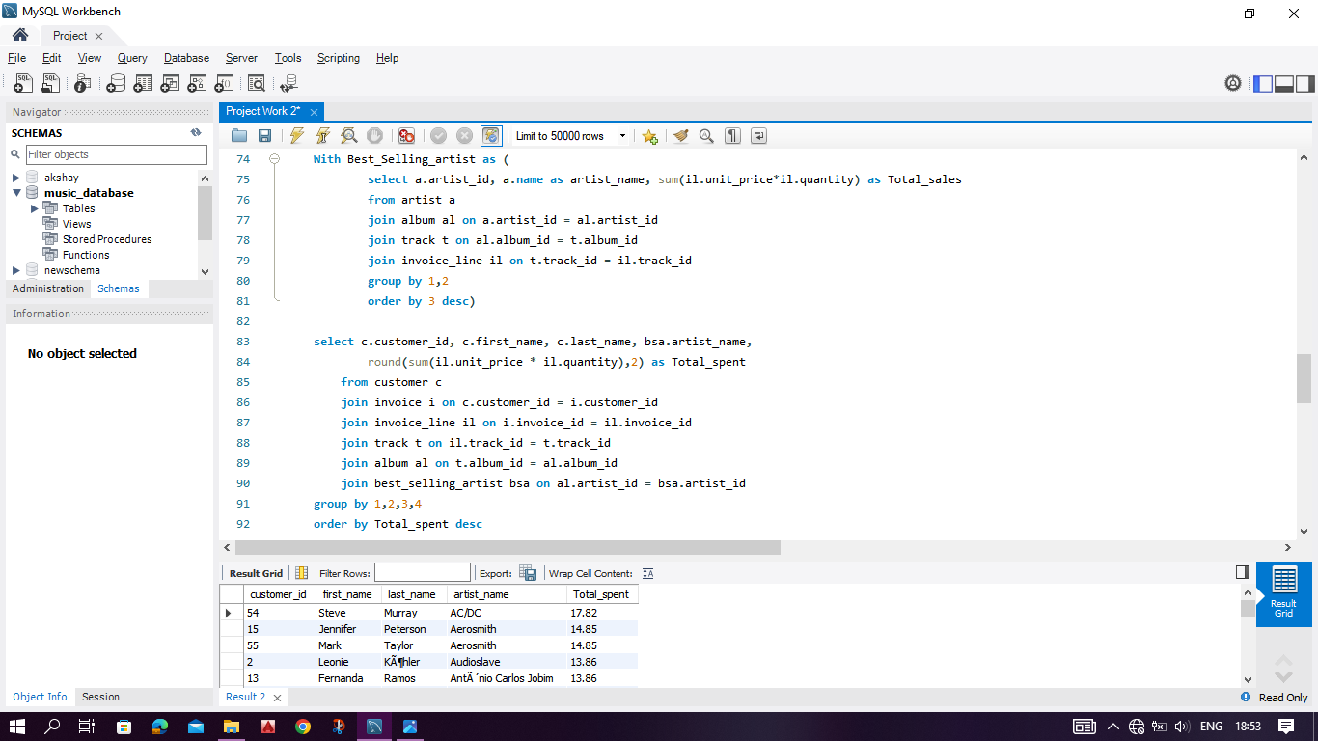
ADVANCE
1. Find how much amount spent by each customer on artists? Write a query to return customer name, artist name and total spent
MUSIC STORE ANALYSIS

Slide 14
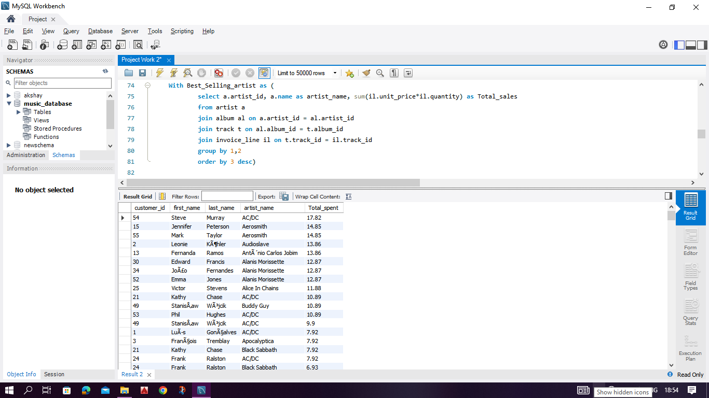
OUTPUT
MUSIC STORE ANALYSIS

Slide 15
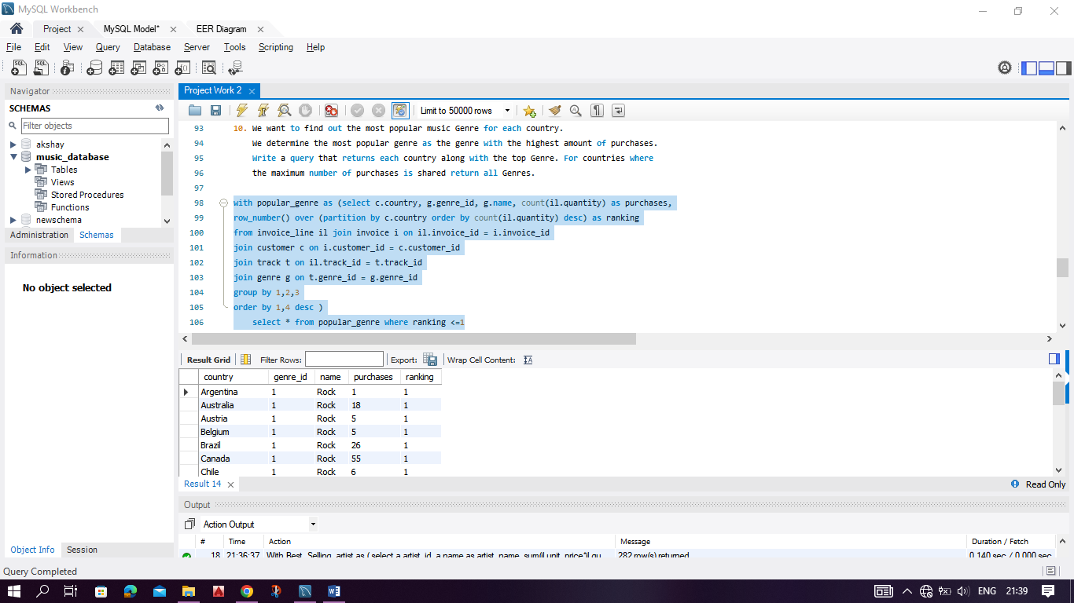
2. We want to find out the most popular music Genre for each country. We determine the most popular genre as the genre with the highest amount of purchases. Write a query that returns each country along with the top Genre.
MUSIC STORE ANALYSIS

Slide 16
OUTPUT
MUSIC STORE ANALYSIS

Slide 17
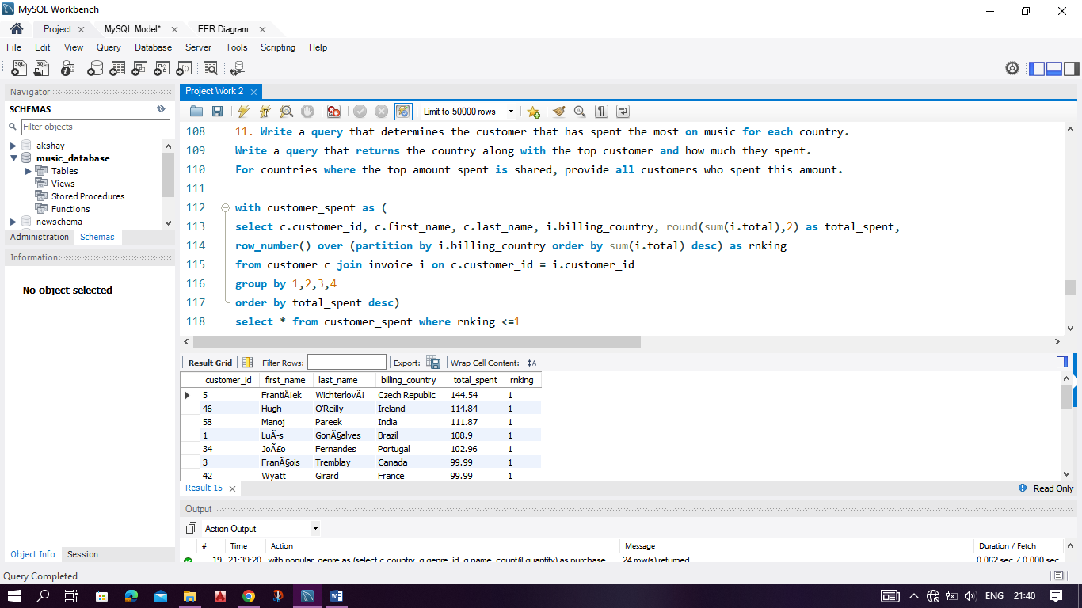
3. Write a query that determines the customer that has spent the most on music for each country. Write a query that returns the country along with the top customer and how much they spent.
MUSIC STORE ANALYSIS

Slide 18
OUTPUT
MUSIC STORE ANALYSIS

Slide 19

THANKS
- Akshay Shirbhate

